Slide 1
The Beers of San Antonio: A Web-Scrape Dive
James Ford
STA 6233: Advanced R Programming
Spring 2021
Project 1

Slide 2
Project Background
Use the Beer Advocate website for each of the breweries and brewpubs in San Antonio to do the following:
1) retrieve the name, style, and rating for each beer they have ratings for
2) calculate and graph summary statistics of the ratings by style
3) conduct text analysis of the names as well as the consumer reviews for select styles to summarize and visualize key terms describing the products to compare and contrast the styles

Slide 3
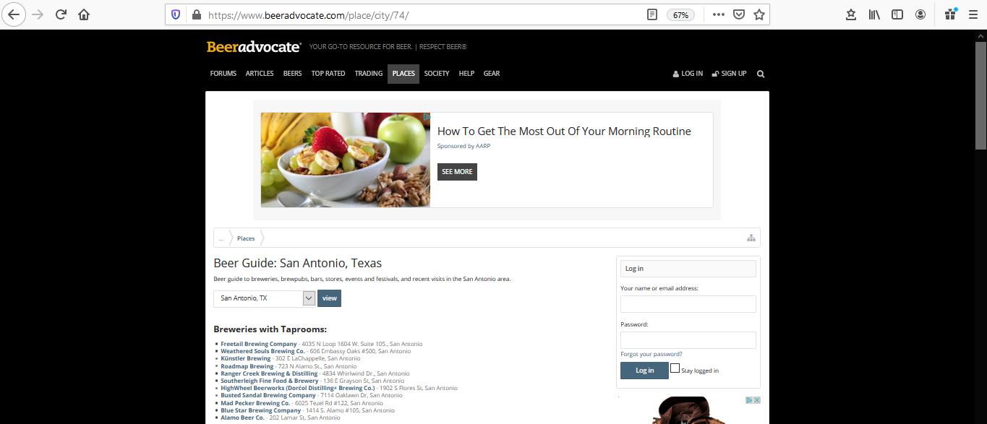

Slide 4
Research Questions
1) What are the most common and the highest rated styles of locally made beers?
2) For the leading styles, how do consumers describe them?
3) What common themes are present in the names of the beers that reflect the local culture?

Slide 5
SAN ANTONIO BREWERS
(as located on https://www.beeradvocate.com/)
Brewer | Count
Alamo Beer Co. | 30
Back Unturned Brewing Company | 17
Blue Star Brewing Company | 38
Busted Sandal Brewing Company | 23
Freetail Brewing Company | 150
HighWheel Beerworks (Dorćol Distilling+ Brewing Co.) | 12
Islla Street Brewing Company | 15
Künstler Brewing | 57
Longtab Brewing | 17
Mad Pecker Brewing Co. | 11
Maverick Whiskey | 10
Ranger Creek Brewing & Distilling | 27
Roadmap Brewing | 24
Southerleigh Fine Food & Brewery | 50
Weathered Souls Brewing Co. | 94

Slide 6
Methodology / R Code
R Libraries Used:
library(tidyverse)
library(stringr)
library(ralger)
library(rvest)
library(RColorBrewer)
library(flextable)
library(tm)
library(SnowballC)
library(wordcloud2)
library(tidytext)
Get List of Breweries:
# San Antonio Main Page
url_city <- 'https://www.beeradvocate.com/place/city/74/'
# get url links to brewers
brewers_abs_urls <- weblink_scrap(link = url_city) #using ralger
brewers_abs_urls <- brewers_abs_urls[(str_sub(brewers_abs_urls,1,14)=='/beer/profile/')]
brewers_abs_urls <- brewers_abs_urls[(str_sub(brewers_abs_urls,-1,-1)=='/')]
brewers_abs_urls <- brewers_abs_urls[!is.na(brewers_abs_urls)]
brewers_abs_urls <- unique(brewers_abs_urls) %>%
url_absolute(url_city)
brewers_all <- data.frame(brewers_abs_urls)

Slide 7
Methodology / R Code (continued)
For Loop to load each brewer’s page (total of 15) and scrape table of beer names, styles, ratings, and url
Combine beer lists into a single dataframe (n = 575 individual beers)
Map beer styles into one of 14 categories, as listed on www.beeradvocate.com/beer/styles
Group by brewer, beer style and beer style category to create summary statistics
Create series of ggplot graphs and flextable table images
For Loop to load each beer’s ratings page and scrape text of rating (n = 471 beers with ratings and 3958 rating comments)
Select several beer style categories to analyze rating text and produce word clouds
Analyze beer names for local cultural terms and word cloud

Slide 8
TABLES
List of Beer Names
List of Beer Styles

Slide 9
Results Part 1
What are the most common and the highest rated styles of locally made beers?
Most common styles: IPA – American (64 / 11% of the total), Stout - American Imperial (59 / 10%), and Pale Ale – American (34 / 6%)
Highest rated styles: Blonde Ale – Belgian (4.42 out of 5 points), Bitter – English (4.20), and Gruit / Ancient Herbed Ale (4.15)
Most common style categories: India Pale Ales (128 / 22%), Stouts (93 / 16%), and Pale Ales (88 / 15%)
Highest rated style categories: Pale Ales (3.46), Stouts (3.43), and Specialty Beers (3.20)

Slide 10
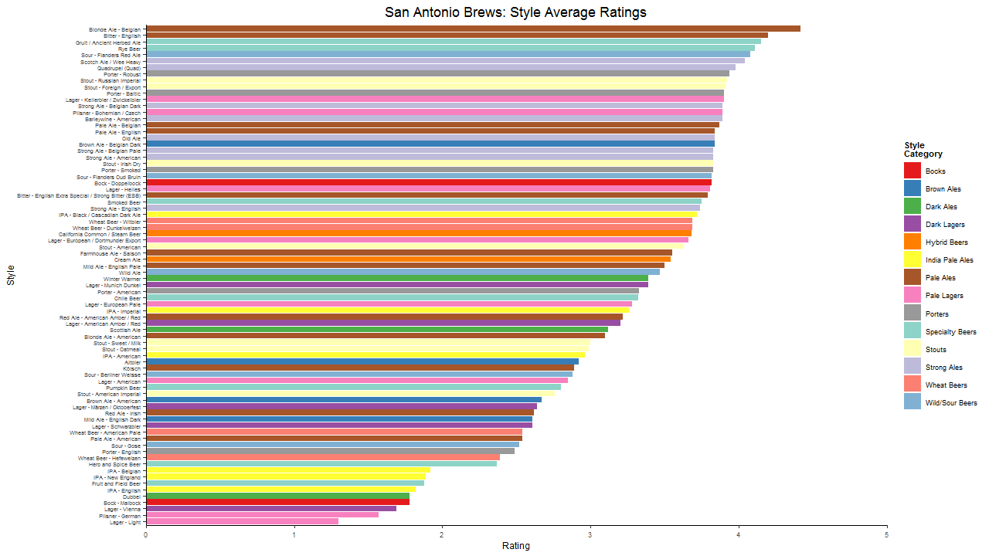

Slide 11
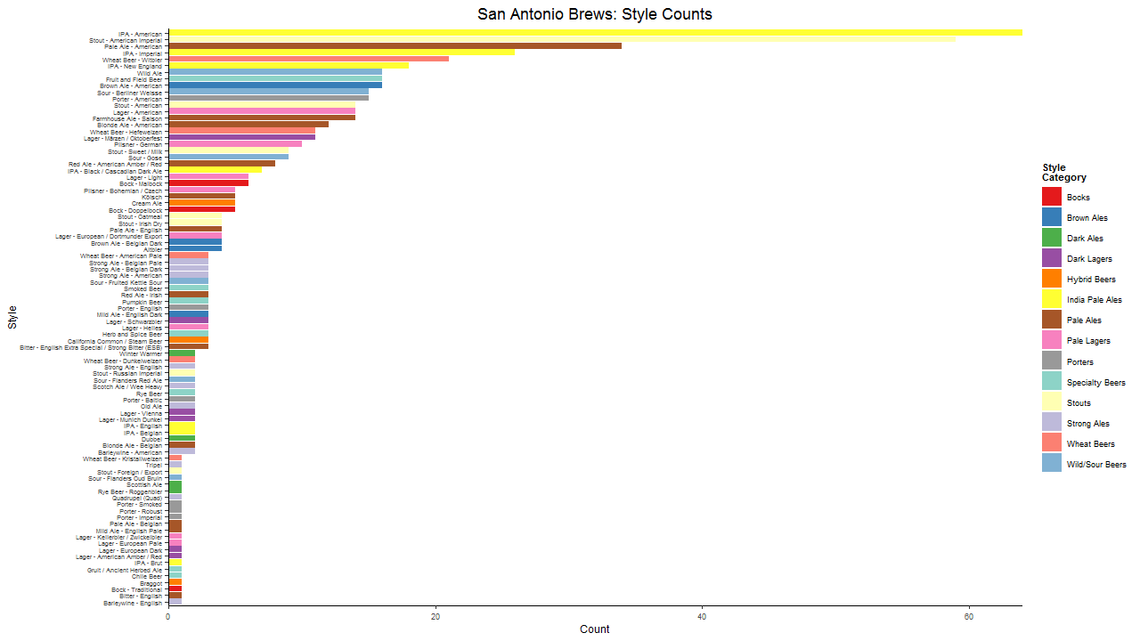

Slide 12
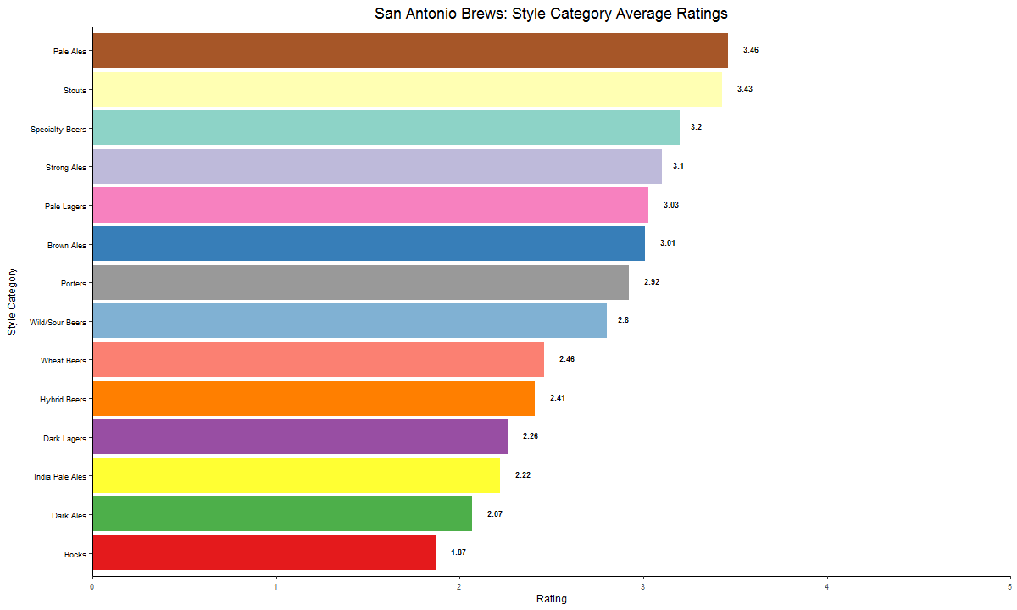

Slide 13
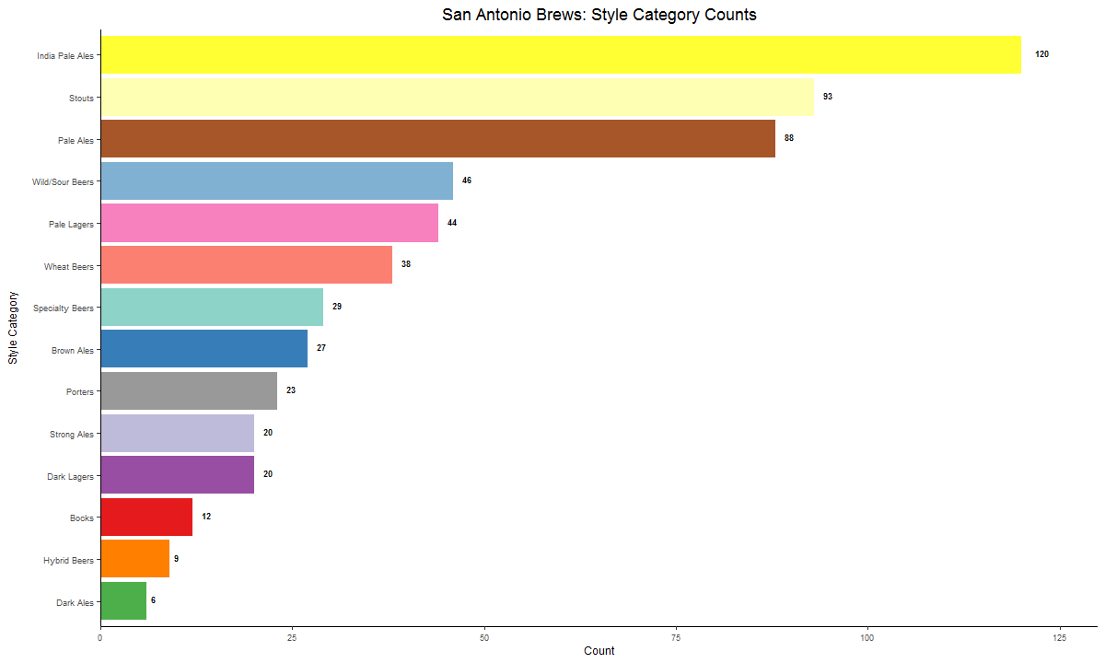

Slide 14
Results Part 2
For the leading styles, how do consumers describe them?
Text analysis of Pales Ales (731 comments) vs Stouts (391) was conducted with word clouds of the approximately top 100 description words listed:
Similarities – Aroma, Balanc(e), Bitter, Carbon(ization), Finish, Flavor, Head, Lace, Light, Malt, Medium, Mouthfeel, Smooth, Sweet, Taste
Pale Ales Only – Amber, Caramel, Citrus, Crisp, Floral, Golden, Hazi(ness), Hop, Nice, Orang(e), White
Stouts Only – Black, Brown, Chocol(ate), Coffe(e), Creami(ness), Milk, Roast, Strawberri(es), Thick, Vanilla

Slide 15
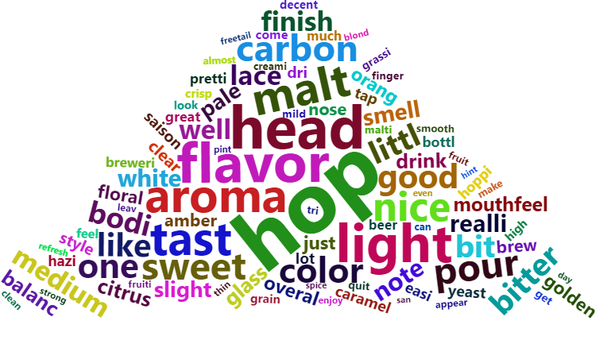
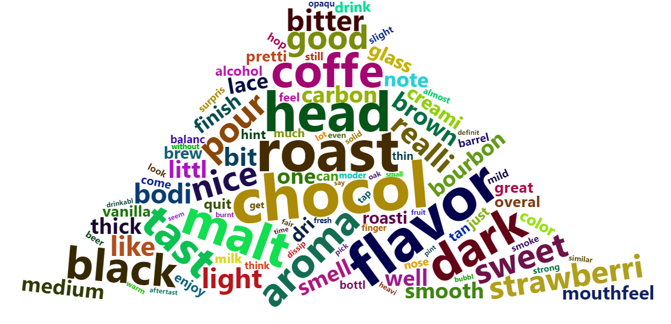
WORD CLOUDS: BEER STYLE CATEGORIES
PALE ALES
STOUTS

Slide 16
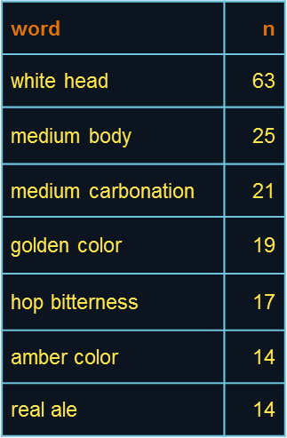
Results Part 2
For the leading styles, how do consumers describe them?
Additionally, two-word N-Grams were created. The top 7 phrases differed considerably.
PALE ALES
STOUTS
word | n
roasted malt | 32
dark brown | 21
dark chocolate | 21
roasted malts | 21
tan head | 17
brown head | 16
black color | 13

Slide 17
Results Part 3
What common themes are present in the names of the beers that reflect the local culture?
Repeated local terms in beer names include (see word cloud):
Alamo, Bexar, Maverick , Mole, Muerta, Puro, Southtown, and Texas
Other culturally interesting name terms include:
210, Applewhite, Bat, Cherry Street, Cinco Peso, Conserveza, Danny Mijo, Davy Bockett, El Gourdo Pumpkin, Fiesta, Ghost Tracks, King William, La Villita, Mission, Piñata, Porteransas, Rio, Riverwalk, Rubia, SoFlo, Tejano, Texican, and Winter Texan

Slide 18
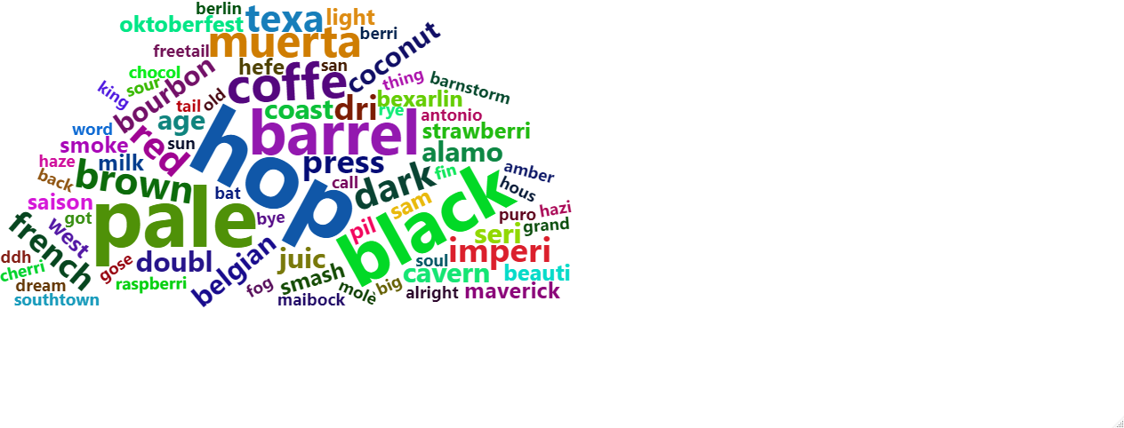
WORD CLOUD: BEER NAMES

Slide 19
THANK YOU

